Slide 1
Modernizing Excellence: A Data-Driven Transformation for Sri Murugan Traders
NAME: SIDDESH N B
ROLL NO: 21F1004657

Slide 2
ORGANIZATION BACKGROUND
Sri Murugan Traders is a venerable and highly regarded establishment that has been an integral part of the Sriperumbudur community for over three and a half decades.
Founded by Mr. P. Sundram, this business has consistently delivered excellence in the field of wholesale rice, earning a strong reputation for quality and reliability.
They are selling 6 different rice varieties namely HMT, BPT, PONNI, STEAM RICE, RAW RICE, BIRYANI RICE which includes totally 39 brands initially but now they are running only with 25 brands from 14 suppliers.
Situated on Gandhi Road in Sriperumbudur, the strategic location has allowed it to serve a diverse clientele, ranging from local grocery stores to restaurants and institutions.
This central location has enabled easy access to suppliers and customers, making it a pivotal hub in the wholesale rice industry.
Sri Murugan Traders has cultivated strong relationships with its customers by prioritizing their needs and preferences.

Slide 3
PROBLEM STATEMENT
SUPPLIER PRICE FLUCTUATIONS: Out of 14 suppliers, typically 10 suppliers contribute to the issue of price fluctuation. As a result, there is a 10% loss of customers and a 10% loss in profit. This problem usually arises during the harvesting period of “JANUARY” and “MAY”.
TAX COMPLIANCE AND STORAGE MANAGEMENT: There is typically a 10% loss in storage management and a 3-4% loss due to this tax system.
INCONSISTENT PRODUCT QUALITY: Usually, 7 suppliers are responsible for inconsistent product quality supplies. This problem results in a 10% loss in profit and a 5% loss in customers. In a given month, approximately 3 rice brands encounter this issue.

Slide 4
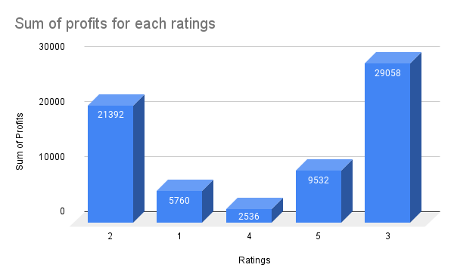
SUM OF PROFITS FOR EACH RATINGS
Factors Driving Profitability in 3 Star and 2 Star Quality Rice Brands:
Price Sensitivity:
Prioritization of affordability boosts sales for 3 Star and 2 Star brands.
Taste Preference:
Aligned taste and texture preferences make these brands more appealing.
Brand Loyalty:
Strong customer loyalty to 3 Star and 2 Star rice resists the shift to higher-rated options.

Slide 5
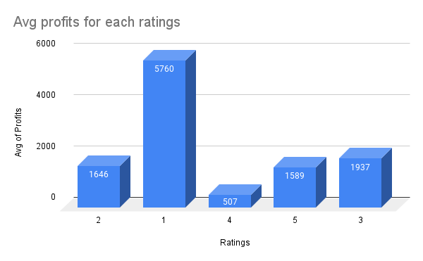
AVG OF PROFITS FOR EACH RATINGS
Key Drivers of High Profit Margins in 1 Star Quality Rice Brands
Bulk Purchases:
High average profits result from bulk orders for canteens, festivals, marriages, schools, companies, and colleges.
Brand Value:
Enhanced brand value further contributes to the success of 1 Star quality rice in the market.

Slide 6
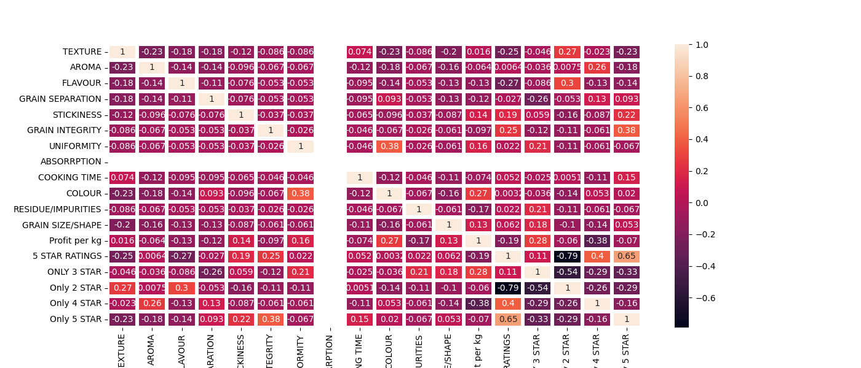

CORRELATION ANALYSIS FOR QUALITY IMPROVEMENT STRATEGIES

Slide 7
Profitability Correlation:
Profits strongly correlate with 3-star rating rice brands, while a negative correlation exists with 5-star ratings due to identified issues.
Quality Problems Impact on 3-Star Rating:
Texture, aroma, grain separation, and color negatively affect 3-star rating brands, emphasizing areas for improvement.
Quality Problems Impact on 2-Star Rating:
Stickiness, color, grain integrity, uniformity, and others influence 2-star rating brands, guiding targeted quality enhancements.
Quality Problems Impact on 4-Star Rating:
Grain shape/size, flavor, cooking time, and others impact 4-star rating brands, highlighting areas for focused improvement.
Quality Problems Impact on 5-Star Rating:
Texture, aroma, flavor, uniformity, and residues impact 5-star rating brands, providing insights for targeted enhancements.
Strategic Recommendations:
Prioritize addressing quality problems for 3-star and 2-star brands in the specified order to maintain and increase profitability.
For 4-star and 5-star brands, consider negotiating price adjustments with sellers instead of returning products, aligning with the preference order of identified problems for mutual profit gains.

Slide 8
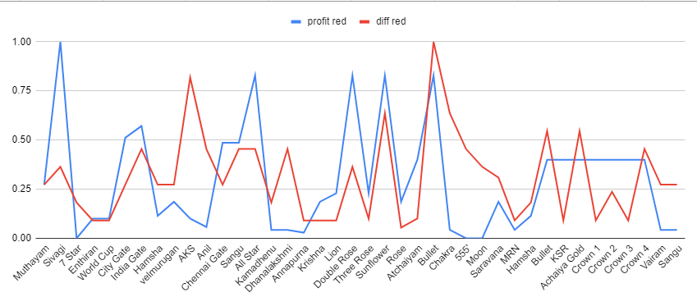
Price Dynamics Analysis and Critical Threshold Point for Rice Brands
Key Insights:
Values above 1 suggest short-term price resilience; exceeding 2 indicates potential sustained increases.
Values below 1 raise concerns for brands with low profit ratios, risking significant devaluation.
Critical Threshold:
20 out of 42 brands, including 7 star, Hamsha, Velmurugan, AKS, Anil, at risk.
Adverse effects possible if additional price increases occur.
Implications:
Strategic reevaluation of pricing crucial to prevent brand devaluation.
Factors like market competition,production costs and consumer expectations contribute to vulnerability.

Slide 9
Mitigating Tax Burden: Collaborative Strategies
Issue:
9 out of 21 rice brands offer bags weighing 25 kgs or less, resulting in higher tax burden.
Despite contributing 20% of overall profit, eliminating them is not viable.
Strategies:
Supplier Collaboration:
Negotiate pricing structures.
Explore innovative solutions.
Government Petitions:
Petitions highlighting economic impact.
Alternative Packaging:
Explore cost-effective weight reductions.
Ensure product integrity.
Benefits:
Addresses immediate tax burden.
Contributes to long-term sustainability and competitiveness of the rice industry.

Slide 10
Machine Learning Applications for Rice Brands
Assigning 5-Star Ratings:
Utilizing ML algorithms for precise 5-star ratings.
Enhancing accuracy through impurity analysis.
Optimal Purchase Quantities:
Leveraging impurity analysis and 5-star ratings for determining optimal purchase quantities.
Enhancing procurement efficiency with ML predictions.
Forecasting Profits:
Unveiling insights into new and established rice brands.
Utilizing impurity analysis and 5-star ratings for accurate profit forecasting with ML algorithms.

Slide 11
Interpretation of Results and Recommendations
For Quality Improvement:
Limited samples collected; enhance ML model accuracy.
Active collection of more samples recommended for 5-star ratings, purchase quantities, and profits.
Correlation Analysis:
Plot correlation table or heatmap for impurities, quality issues, 5-star ratings, and profits.Explore interrelationships to gain insights for strategic decision-making.
For Consumer Satisfaction:
Provide consumers with modified cooking instructions.
Empower consumers to overcome issues, enhancing overall satisfaction.
For Tax Regulation Issues:
Encourage suppliers to provide bags larger than 26 kgs.
Strategic alignment for tax compliance and business profitability.
For Supplier Price Fluctuations:
Gather historical price details and profit data.
Create plots to visually analyze trends.
Correlate results to identify supplier practices leading to price increases.
Strategize accordingly for stable pricing.
THANK YOU

